Slide 1
Welcome!
Thanks for joining us
Notes:
© Copyright Showeet.com – Creative & Free PowerPoint Templates

Slide 2




Let my introduce my team
4nn
Pasha Lysyi
Alim Bektimirov
Sasha Bondarchuk
Bohdan Tkachuk
Notes:
© Copyright Showeet.com – Creative & Free PowerPoint Templates

Slide 3
4nn team
Wi
Notes:
© Copyright Showeet.com – Creative & Free PowerPoint Templates

Slide 4

Wi ?
pe
dia
Wi
ki

Slide 5
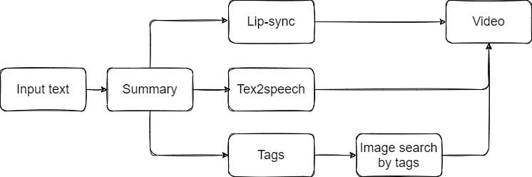
UML

Slide 6

Use case
The application helps the child learn effectively and increases interest in new information

Slide 7
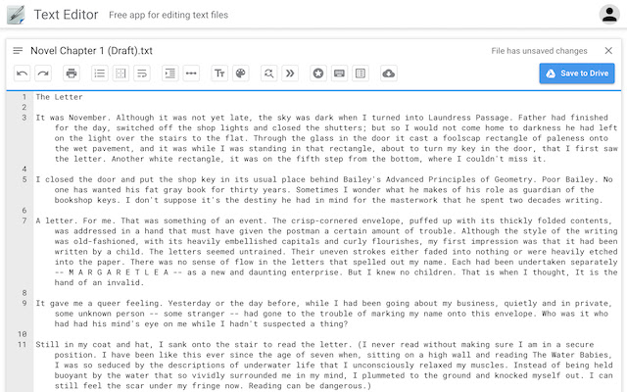
INPUT
Notes:
© Copyright Showeet.com – Creative & Free PowerPoint Templates

Slide 8
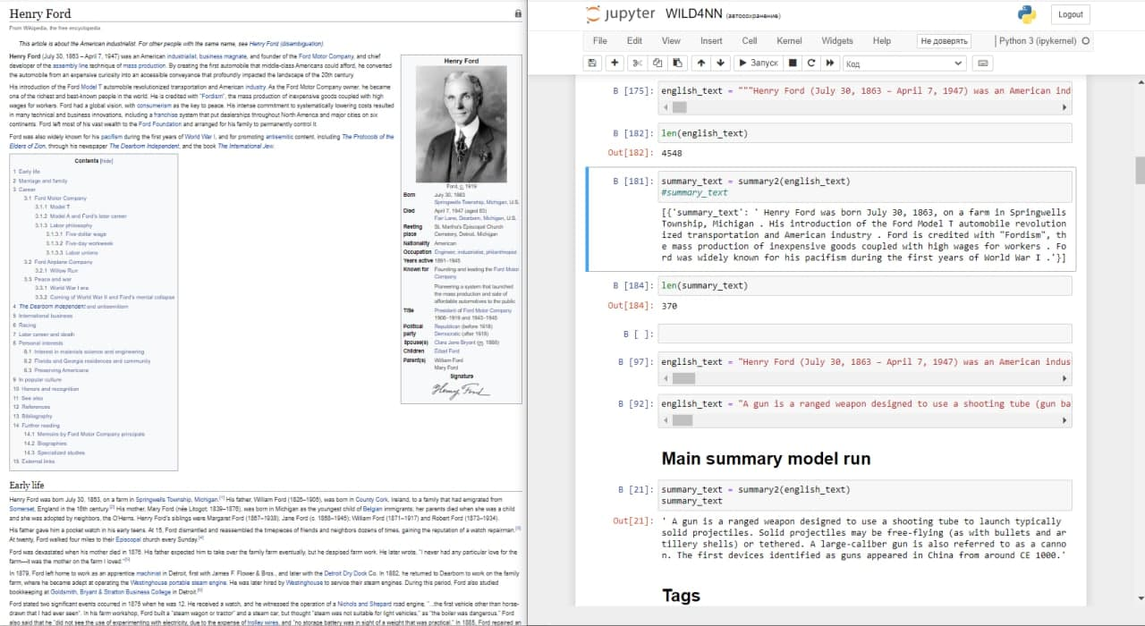
Summary
INPUT
OUTPUT
4548 sign
370 sign

Slide 9
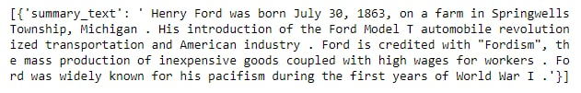
Summary result
370 sign
Сompression about 12 times

Slide 10

Text2Speech
Text2Speech
https://hey.reface.ai/
Reface API
Notes:
© Copyright Showeet.com – Creative & Free PowerPoint Templates

Slide 11
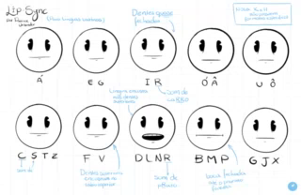
Lip-sync
Lip-sync
https://hey.reface.ai/
Reface API
Notes:
© Copyright Showeet.com – Creative & Free PowerPoint Templates

Slide 12
Tags
NLTK+SPACY+TF-IDM
Notes:
© Copyright Showeet.com – Creative & Free PowerPoint Templates

Slide 13

TAGS Method`s
01
NLTK
https://www.nltk.org/book/
02
SPACY
https://spacy.io/
03
TF-IDM METHOD
https://ru.wikipedia.org/wiki/TF-IDF
Notes:
© Copyright Showeet.com – Creative & Free PowerPoint Templates

Slide 14
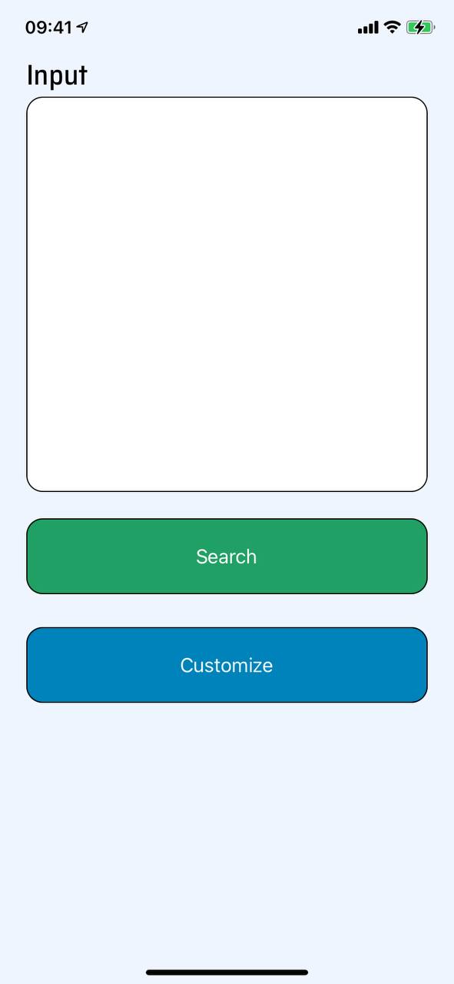
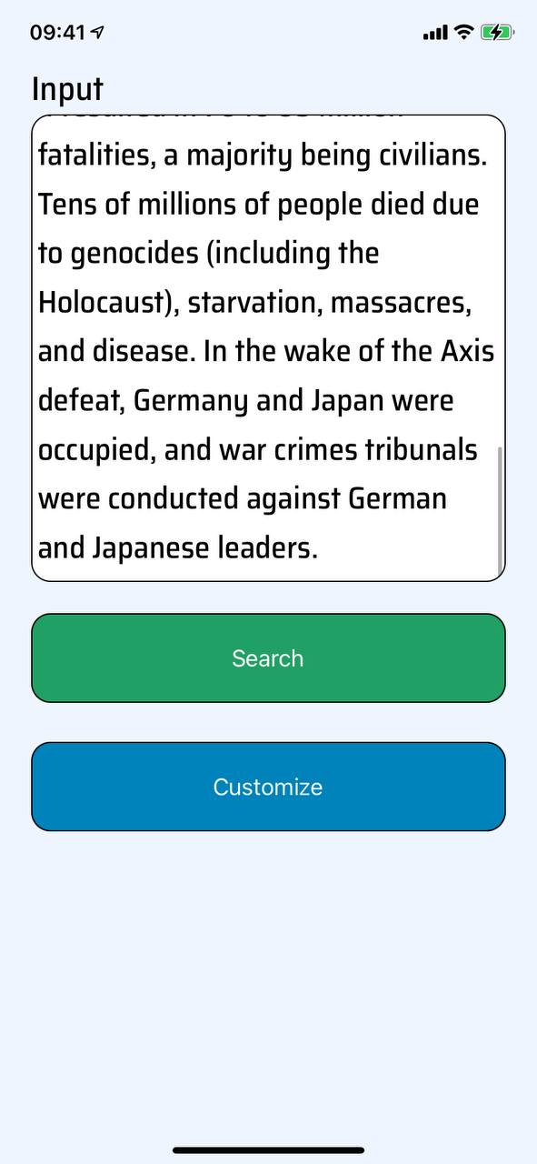
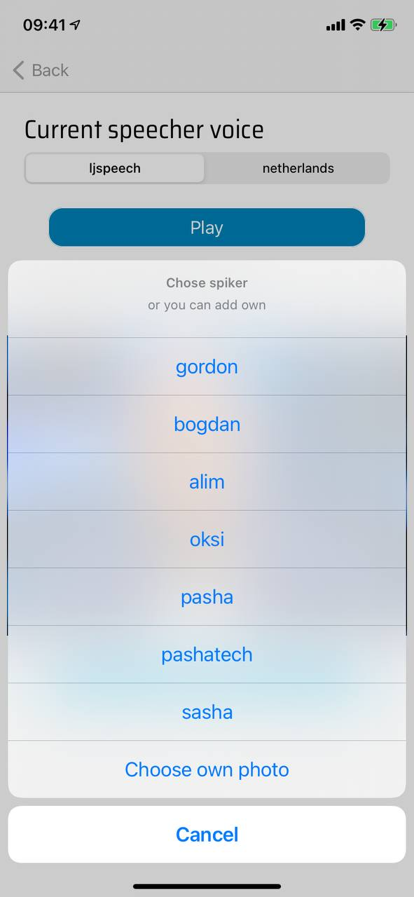
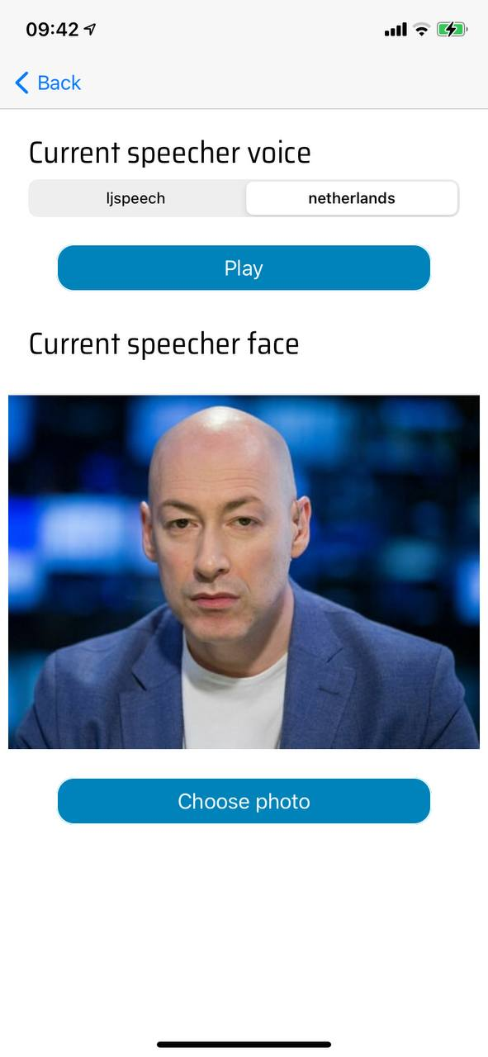
UI

Slide 15
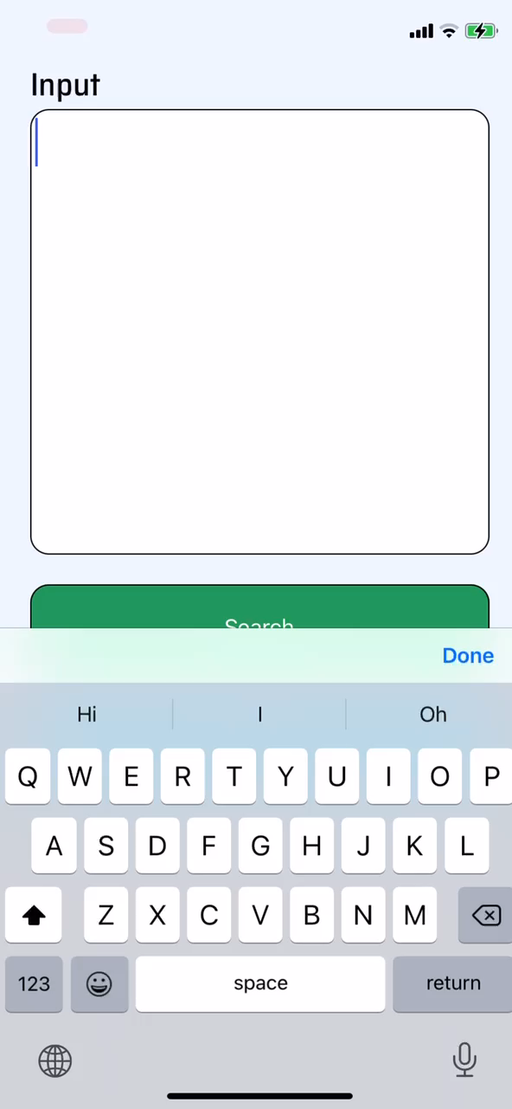
Real OUTPUT

Slide 16
Improvement
Use Reenactment to add more realism.
Add ability to choose the strength of the compression of the text.
Diversify incoming text formats.
Add subtitles.
Video accelerator.
Add apps for Android/Web.

Slide 17
It was 4nn
Our personal statistica during wild hack:
4.6 hours of sleep at all!
2 nights on the terrace, which means practically on the street!!!
After 15 energetic, we stopped counting their number ….
Meet over 20 cool guys and girls!!
90% of the planned ideas were implemented!!!
Notes:
© Copyright Showeet.com – Creative & Free PowerPoint Templates

Slide 18
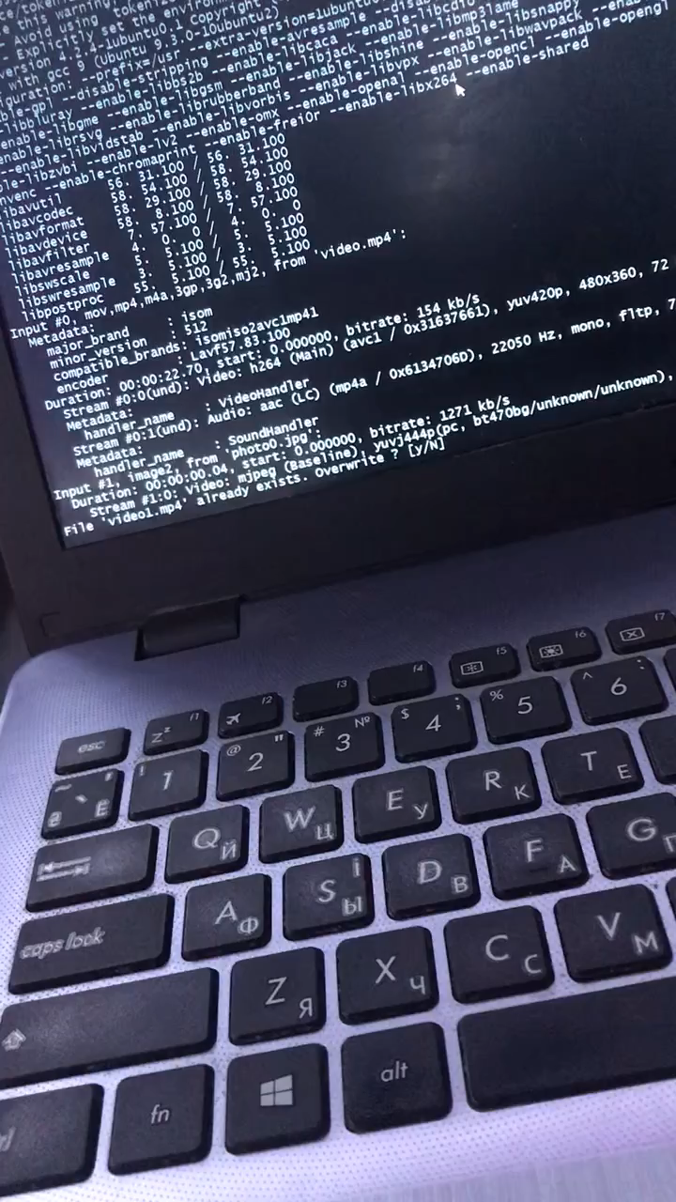
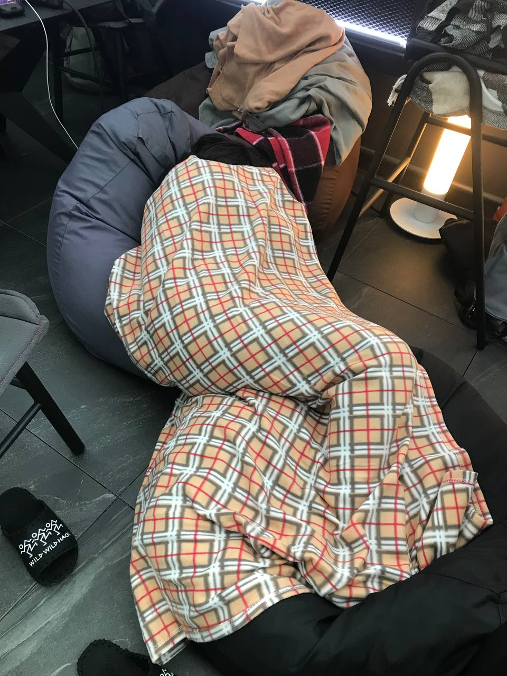
ALIM
Notes:
© Copyright Showeet.com – Creative & Free PowerPoint Templates

Slide 19
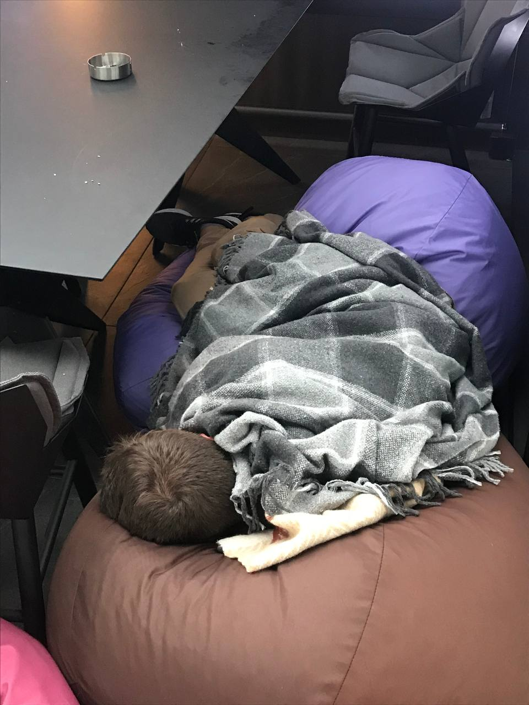
SASHA
Notes:
© Copyright Showeet.com – Creative & Free PowerPoint Templates

Slide 20
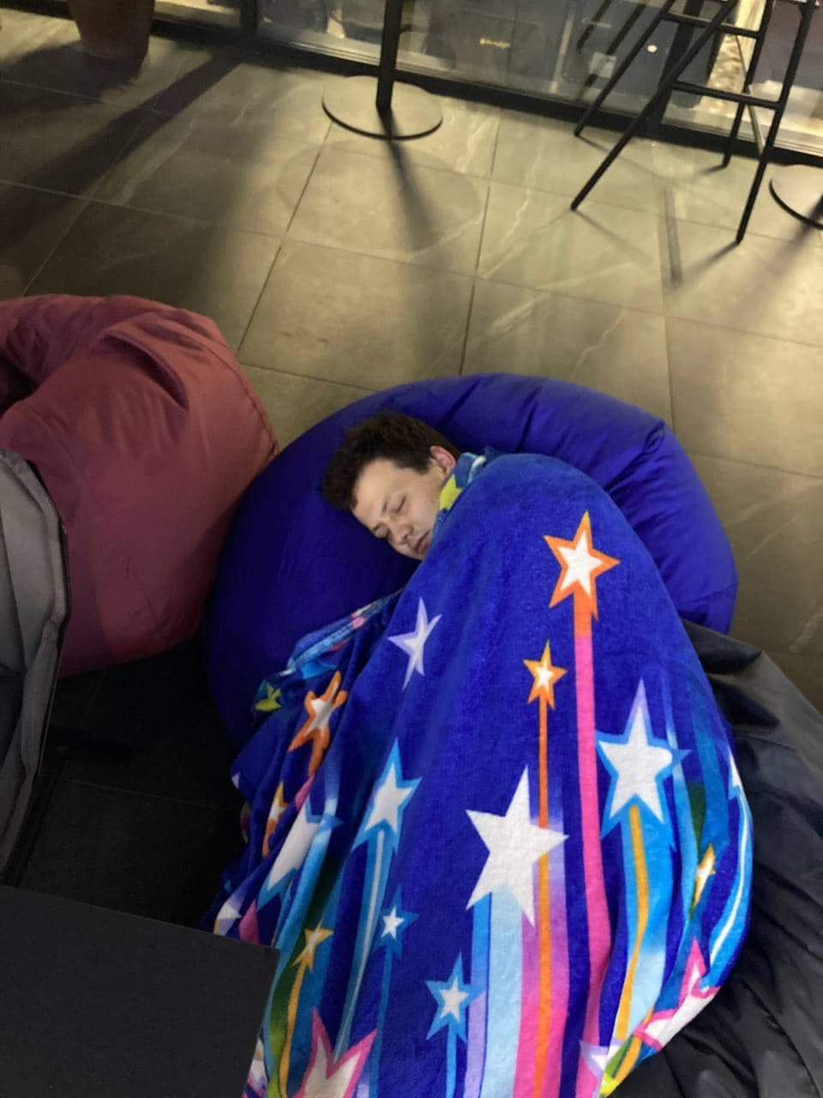
BODYA
Notes:
© Copyright Showeet.com – Creative & Free PowerPoint Templates

Slide 21
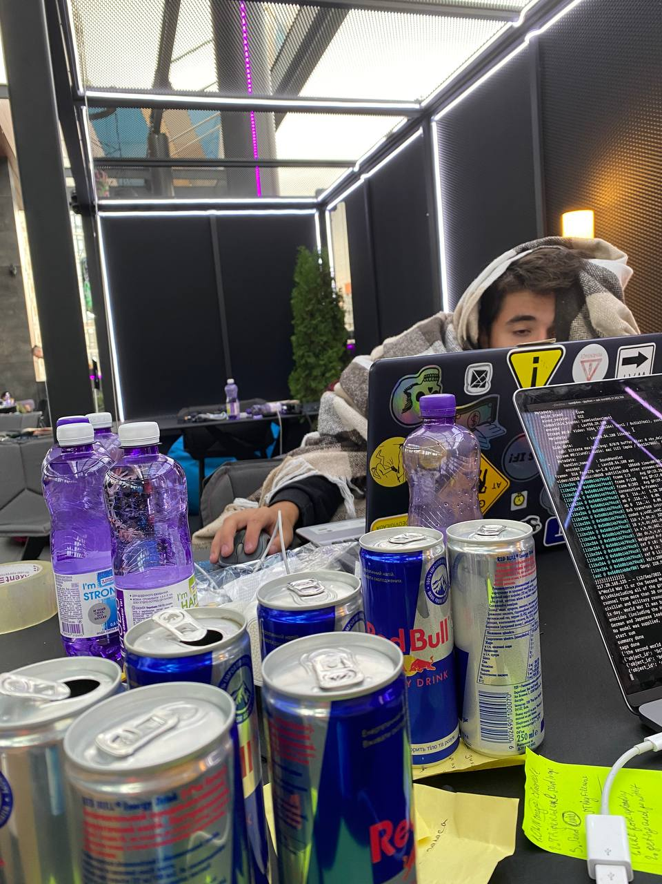
PASHA
Notes:
© Copyright Showeet.com – Creative & Free PowerPoint Templates

Slide 22

Thank You!
4NN
PRESENTATION EXPERT
1234 Lorem St, Ipsum, 56789, Country
+380505612764
Lysyi.pavlos@email.com
Notes:
© Copyright Showeet.com – Creative & Free PowerPoint Templates

